Slide 1

ASSOCIATION OF UKRAINIAN CITIES –
REPRESENTATIVE OF HROMADAS’ INTERESTS IN POLICY DIALOGUE WITH CENTRAL AUTHORITY
MYKOLIUK NAZAR
AUC Advisor

Slide 2

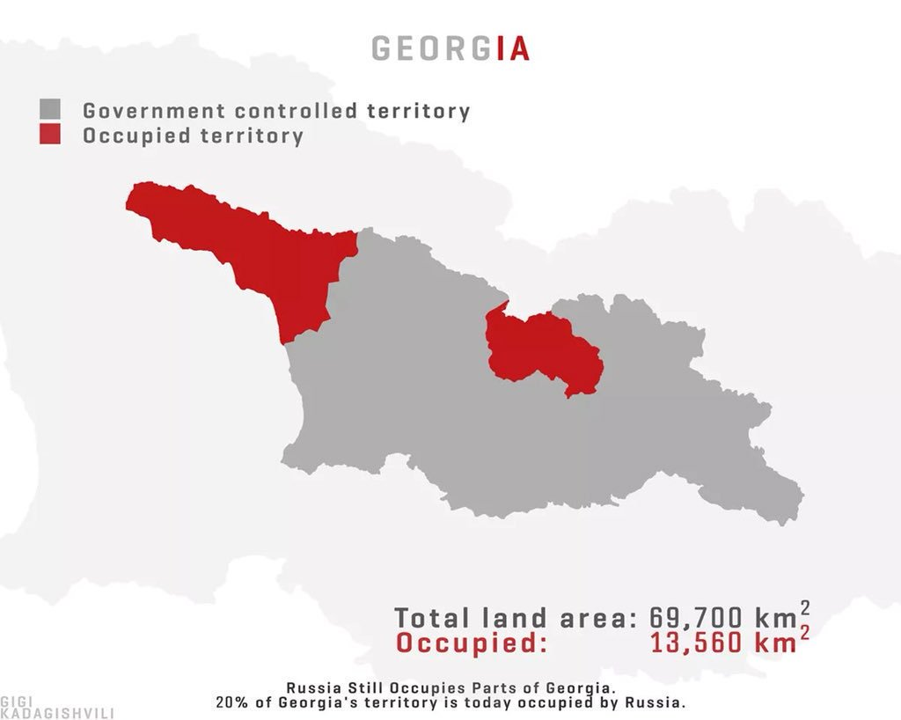
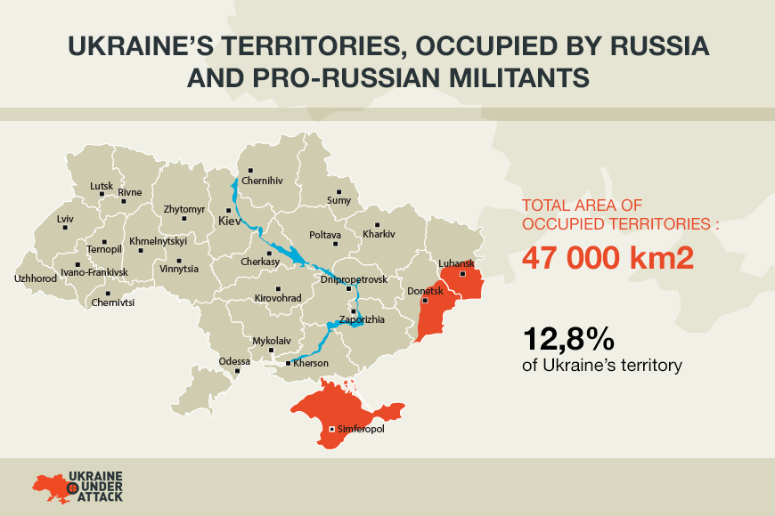

Slide 3




Slide 4

ASSOCIATION OF UKRAINIAN CITIES
most powerful non-government organization in Ukraine which represents the position and advocates interests of local governance
founded in 1992
has a status of All-Ukrainian association under the Law of Ukraine on associations of local governments

Slide 5
ASSOCIATION OF UKRAINIAN CITIES
unites 872 territorial communities
484 of which - amalgamated territorial
communities
80% Ukrainian population
As of January, 2020

Slide 6

AUC members:

Slide 7
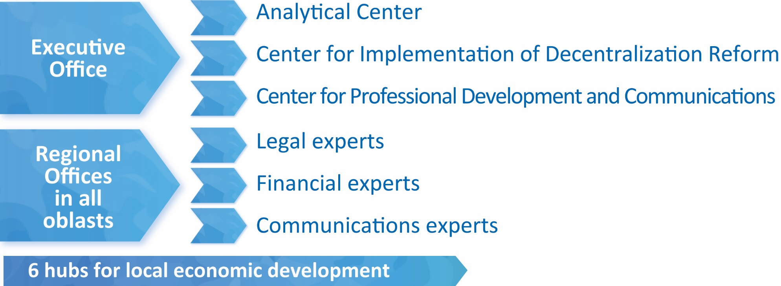
ASSOCIATION OF UKRAINIAN CITIES – REPRESENTATIVE OF HROMADAS’ INTERESTS IN DIALOGUE WITH CENTRAL AUTHORITY
Analytical and expert support, involvement of local governments in determining of AUC position are provided by:
AUC experts help communities in all regions of Ukraine to prepare development strategies and their implementation plans, to develop investment passports and projects to promote small and medium-sized entrepreneurship

Slide 8
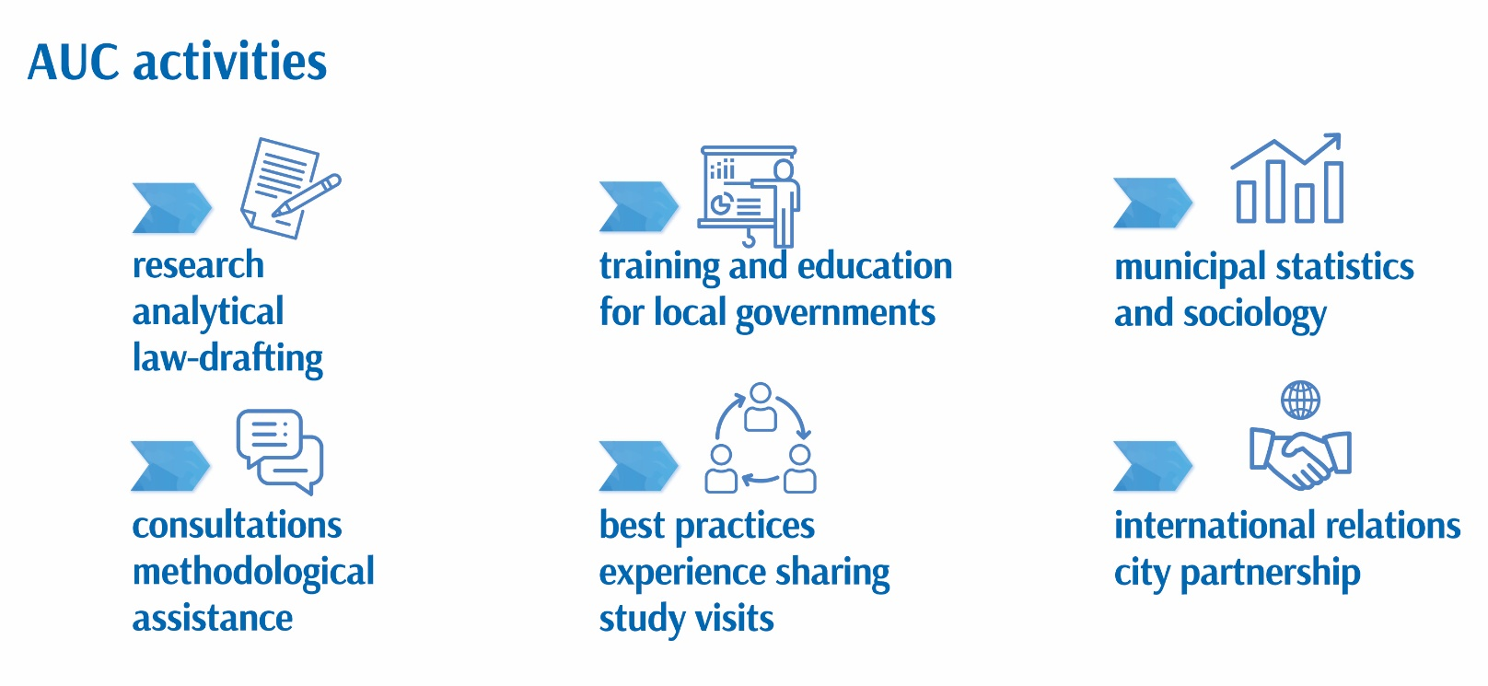

Slide 9
ASSOCIATION OF UKRAINIAN CITIES – REPRESENTATIVE OF HROMADAS’ INTERESTS IN DIALOGUE WITH CENTRAL AUTHORITY
The Association of Ukrainian Cities, upholding the principles of local democracy, transparency and accountability of the authority, represents and advocates the interests of territorial communities, conducts on their behalf a policy dialogue with the central authority:
with Parliament - Local Government Caucus “For Local Government”
with the President - AUC membership in the Regional Development Council
with the Cabinet of Ministers - participation in working sessions of the Government and Governmental Committees on a permanent basis with the right of advisory vote on issues related to local self-government
with central and regional executive authorities - various working groups and sectoral forums

Slide 10
ASSOCIATION OF UKRAINIAN CITIES – REPRESENTATIVE OF HROMADAS’ INTERESTS IN DIALOGUE WITH CENTRAL AUTHORITY
DIALOGUE WITH PARLIAMENT
Work with the Parliamentary Committees
Work with Parliament in general
Work with single MP`s
Cooperation with Parliamentary Committees for 2019:
AUC representatives took part in 80 meetings of 11 Committees
AUC sent 70 expert opinions on draft laws
Due to the joint activity of the Association of Ukrainian Cities and Parliamentary Committees, in 2020 budget process, an additional resource of UAH 48.5 billion was envisaged to all territorial communities in general

Slide 11
ASSOCIATION OF UKRAINIAN CITIES – REPRESENTATIVE OF HROMADAS’ INTERESTS IN DIALOGUE WITH CENTRAL AUTHORITY
DIALOGUE WITH THE PRESIDENT
AUC membership in the Regional Development Council
Regional Development Council created to facilitate the interaction of public authorities with local self-government bodies in the following areas:
development of local self-government
decentralization
solving problems of regional livelihoods

Slide 12
ASSOCIATION OF UKRAINIAN CITIES – REPRESENTATIVE OF HROMADAS’ INTERESTS IN DIALOGUE WITH CENTRAL AUTHORITY
DIALOGUE WITH THE CABINET OF MINISTERS
AUC participate in working sessions of the Government and Governmental Committees on a permanent basis with the right of advisory vote on issues related to local self-government

Slide 13
ASSOCIATION OF UKRAINIAN CITIES – REPRESENTATIVE OF HROMADAS’ INTERESTS IN DIALOGUE WITH CENTRAL AUTHORITY
DIALOGUE WITH Ministries
officiall approval
dialogue about different positions
co-authorship of bills

Slide 14
THANK YOU!
AUC contacts:
tel.: +38044 486 28 78
info@auc.org.ua
www.auc.org.ua

